Slide 1
Breast Cancer Classification and Prediction
Created by: -
Ayushya Verma

Slide 2
Info
Breast cancer (BC) is one of the most common cancers among women in the world today.
A correct diagnosis of BC and classification of tumors into malignant or benign groups

Slide 3
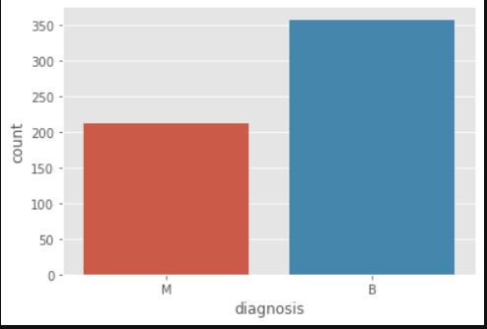
Data
Obtained from Kaggle. It contains 596 rows and 32 columns of tumor shape and specification
The tumor is classified as malignant or benign

Slide 4
DATA DESCRIPTION
• tumor radius (mean of distances from center to points on the perimeter) • texture (standard deviation of gray-scale values) • area • smoothness (Local variation in radius lengths) • compactness (perimeter2 / area — 1.0) • concavity (severity of concave portions of the contour) • concave points (number of concave portions of the contour) • symmetry • fractal dimension
The mean, standard error and “worst” or largest (mean of the three largest values) of these features were computed for each image, resulting in 30 features.

Slide 5
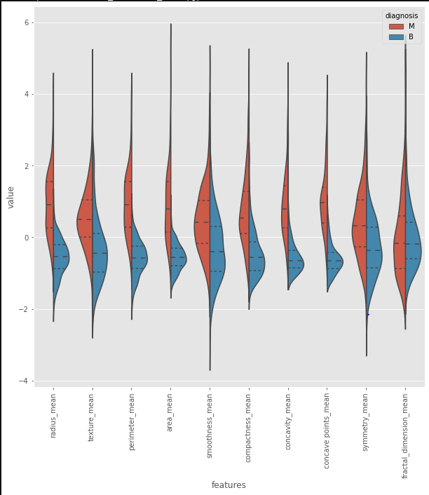
Violin plots for all the means

Slide 6
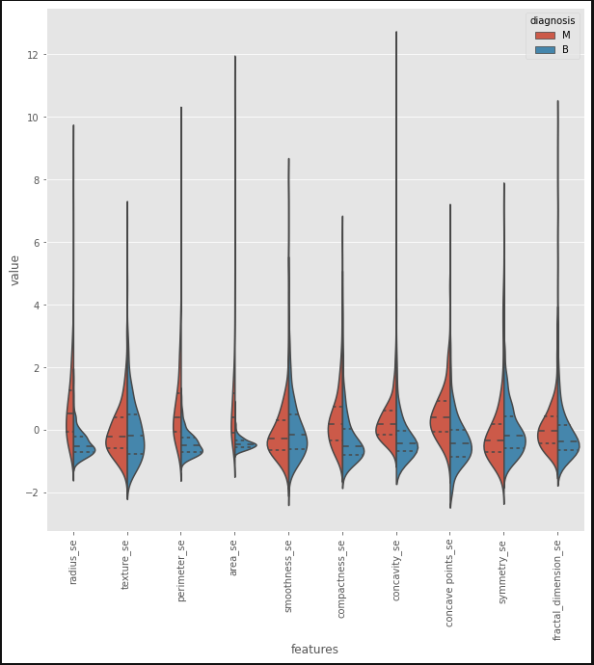
Violin plots for all the standard errors

Slide 7
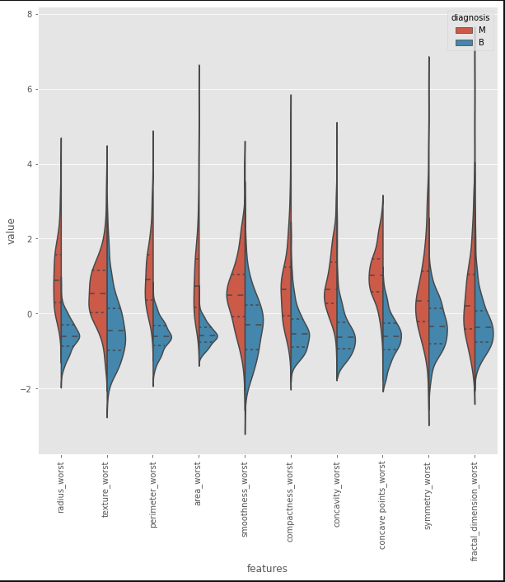
Violin plots for all the worst dimensions

Slide 8
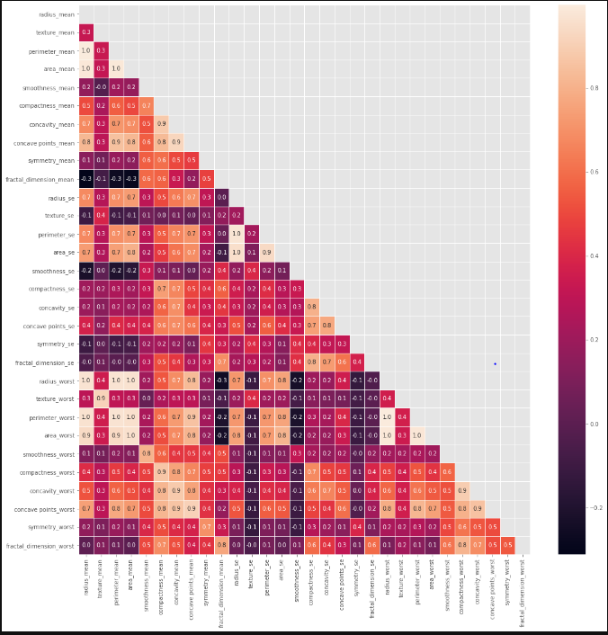
Multi collinearity check via correlation matrix

Slide 9
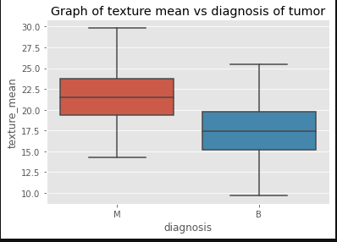
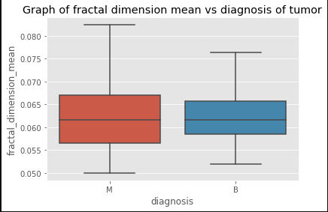

Slide 10
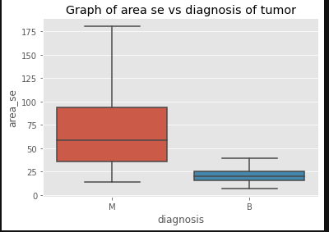
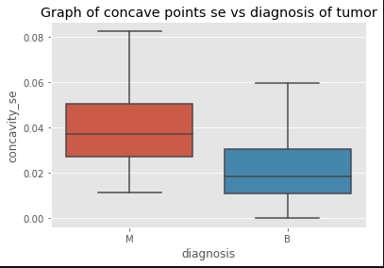

Slide 11
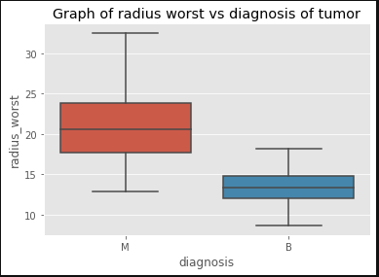
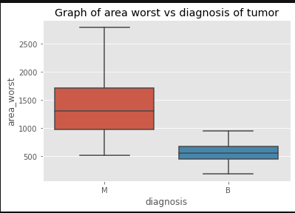

Slide 12
Statistical analysis: t test
Feature | T-Static | P-value
Texture mean | 10.86720108000000 | 4.05863605e-25
fractal dimension mean | -0.30571113 | 0.7599368
Area se | 15.6093429 | 5.89552139e-46
Concave point se | 6.24615734 | 8.26017617e-10
Radius worst | 29.33908156 | 8.48229192e-116
Area worst | 25.7215903 | 2.8288477e-97

Slide 13
ML methodology
Data manipulation: skLearn's LabelEncoder was used to convert the categorical dependent variable (M or B) of the diagnosis column to a numeric data type. Train Test Split: skLearn’s train_test_split was used to split the dataset into training and test sets. 40% of the data was reserved for testing purposes. The dataset was stratified in order to preserve the proportion of target as in the original dataset, in the train and test datasets as well. Feature Scaling: skLearn’s RobustScaler was used to scale the features of the dataset. The centering and scaling statistics of this scaler are based on percentiles and are therefore not influenced by a few number of very large marginal outliers. Training and Testing: The scaled dataset was then trained and tested using Logistic Regression, SVC, Decision Tree and Random Forest algorithms. Hyperparameter tuning: Each model’s parameters were tuned using GridSearchCV in order to improve the model performance. Custom Thresholding: Finally, a custom threshold was set instead of the default 0.5 threshold value, to try and improve the model performance further

Slide 14
Summary of ml results
Model Type | Initial Value | Hyperparameter | Final Value
Logistic Regression | FN:2 FP:1 | Best Penalty: 12 Best C: 0.591 | FN:1 FP:2
SVC | FN:4 FP:2 | 0:0.07100000000000001 kernel: linear | FN:3 FP:0
Decision Tree | FN:5 FP:14 | max_depth: 3 max_features: 0.4 min_samples_leaf: 0.06 | FN:4 FP:14
Random Forest | FN:6 FP:4 | max_depth: 15 max_features: 10 min_samples_split: 3 n_estimators : 100 | FN:2 FP:4

Slide 15
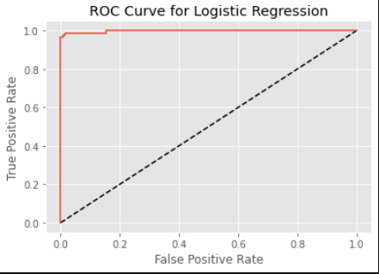
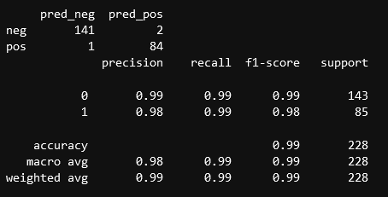
The AUC score for the Logistic regression model is 0.9980 and it has a minimum number of misclassifications for the positive class.

Slide 16
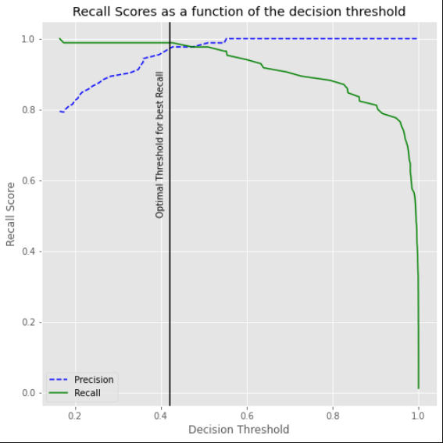
A threshold of 0.42 was chosen for maximum recall.

Slide 17
Conclusion
Among allthe algorithms tried out, the Logistic Regression and Support Vector Classifier gave maximum accuracies and minimum misclassifications for the positive class
The goal was to maximize recall values so as to avoid misclassifications of FN type
Both the models performed exceedingly well. The recall scores were 0.99 and 0.96 for Logisitc Regression and SVC respectively.

Slide 18
Thank you

